Slide 1
19CSE313 – Principles of Programming Languages
Classes and Objects

Slide 2
CLASSES, FIELDS, AND METHODS
class ChecksumAccumulator {
// class definition goes here
}
new ChecksumAccumulator
ChecksumAccumulator objects creation

Slide 3
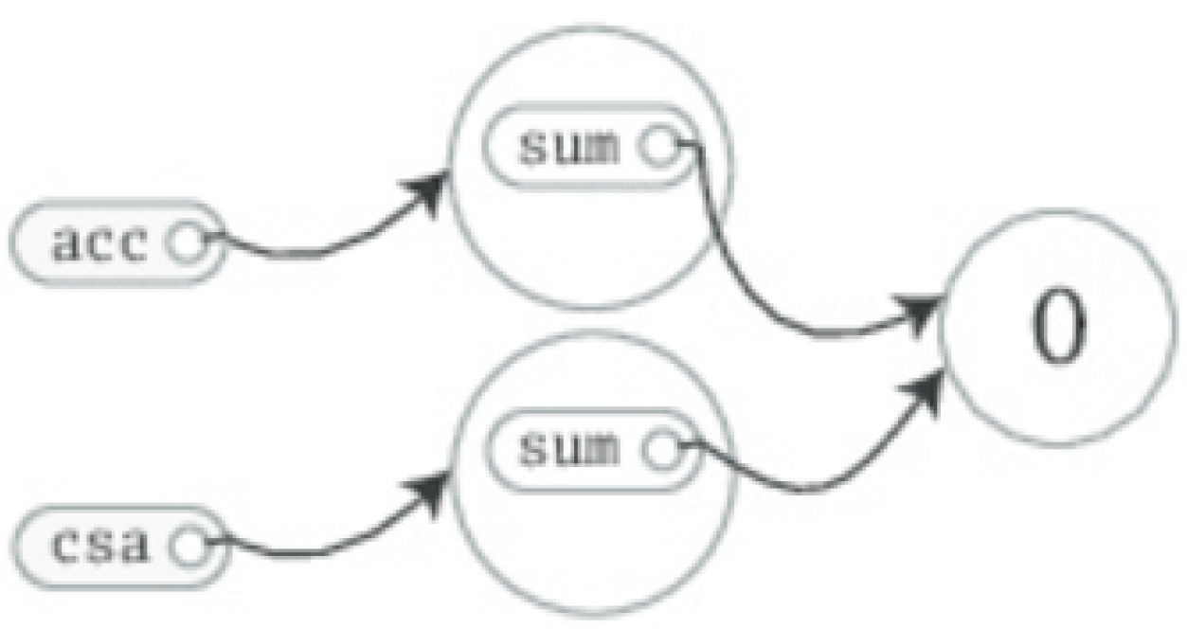
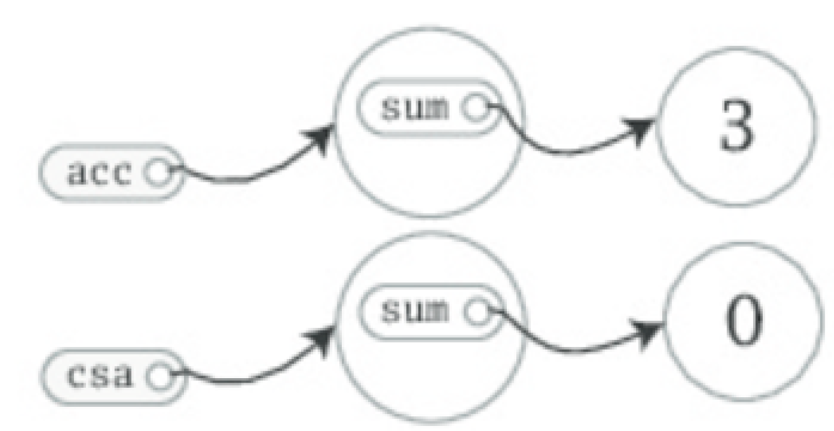
Members (Fields and methods)
class ChecksumAccumulator {
var sum = 0
}
val acc = new ChecksumAccumulator
val csa = new ChecksumAccumulator
acc.sum = 3
Two Instantiations
Since sum is var

Slide 4
Private fields
class ChecksumAccumulator {
private var sum = 0
}
Private fields can only be accessed by methods defined in the same class
Members are made public in Scala is by not explicitly specifying any access modifier
Public is Scala's default access level
val acc = new ChecksumAccumulator
acc.sum = 5 // Won't compile, because sum is private

Slide 5
Methods to access private fields
class ChecksumAccumulator {
private var sum = 0
def add(b: Byte): Unit = {
sum += b
}
def checksum(): Int = {
return ~(sum & 0xFF) + 1
}
}
Any parameters to a method can be used inside the method.
Method parameters in Scala are vals, not vars and cannot be reassigned
def add(b: Byte): Unit = {
b = 1 // This won't compile, because b is a val
sum += b
}

Slide 6
A more concise ChecksumAccumulator
// In file ChecksumAccumulator.scala
class ChecksumAccumulator {
private var sum = 0
def add(b: Byte): Unit = { sum += b }
def checksum(): Int = ~(sum & 0xFF) + 1
}
Methods with a result type of Unit, such as ChecksumAccumulator's add method, are executed for their side effects.
A side effect is generally defined as mutating state somewhere external to the method or performing an I/O action.
In add's case, the side effect is that sum is reassigned.
A method that is executed only for its side effects is known as a procedure.
It is often better to explicitly provide the result types of public methods declared in a class even when the compiler would infer it for you

Slide 7
SEMICOLON INFERENCE
In a Scala program, a semicolon at the end of a statement is usually optional if the statement appears by itself on a single line.
A semicolon is required if you write multiple statements on a single line
Example: val s = "hello"; println(s)
Parsing Multi-line statements
if (x < 2)
println("too small")
else
println("ok")
If you want to enter a statement that spans multiple lines, most of the time you can simply enter it and Scala will separate the statements in the correct place.
Treated as single 4-line statement

Slide 8
Parsing as single statement
Occasionally, however, Scala will split a statement into two parts against your wishes:
x
+ y
This parses as two statements x and +y.
If you intend it to parse as one statement x + y, you can always wrap it in parentheses:
(x
+ y)
Alternatively, you can put the + at the end of a line.
x +
y +
z
Whenever you are chaining an infix operation such as +, it is a common Scala style to put the operators at the end of the line instead of the beginning

Slide 9
RULES OF SEMICOLON INFERENCE
A line ending is treated as a semicolon unless one of the following conditions is true:
The line in question ends in a word that would not be legal as the end of a statement, such as a period or an infix operator.
The next line begins with a word that cannot start a statement.
The line ends while inside parentheses (...) or brackets [...], because these cannot contain multiple statements anyway.

Slide 10
SINGLETON and companion OBJECTS
Scala is more object-oriented than Java is that classes in Scala cannot have static members.
Instead, Scala has singleton objects.
A singleton object definition looks like a class definition, except instead of the keyword class you use the keyword object
When a singleton object shares the same name with a class, it is called that class's companion object.
You must define both the class and its companion object in the same source file.
The class is called the companion class of the singleton object.
A class and its companion object can access each other's private members.

Slide 11
ChecksumAccumulator singleton object
// In file ChecksumAccumulator.scala
import scala.collection.mutable
object ChecksumAccumulator { //key word class used instead of object
private val cache = mutable.Map.empty[String, Int] //previous calc’d checksums are cached
def calculate(s: String): Int = //inputs string and calculates checksum
if (cache.contains(s)) // check if already present as key in map
cache(s) // if present, return the mapped value
else { //calculate check sum
val acc = new ChecksumAccumulator //new check sum instance
for (c <- s) //cycles through each character
acc.add(c.toByte) //converts the character to a Byte and calls add()
val cs = acc.checksum() //invokes checksum() on acc
cache += (s -> cs) //string key mapped to checksum value & added to cache
cs } } // cs is the result of the method

Slide 12
Scala application
// In file Summer.scala
import ChecksumAccumulator.calculate
object Summer {
def main(args: Array[String]) = {
for (arg <- args)
println(arg + ": " + calculate(arg))
}
}
D:\PPL\Scala>scalac ChecksumAccumulator.scala Summer.scala
D:\PPL\Scala>scala Summer of love
of: -213
love: -182

Slide 13
Classes vs singleton objects
Singleton objects cannot take parameters, whereas classes can.
Singleton object cannot be instantiated with the newkeyword, hence no way to pass parameters to it.
Each singleton object is implemented as an instance of a synthetic class referenced from a static variable, so they have the same initialization semantics as Java statics.
In particular, a singleton object is initialized the first time some code accesses it.
A singleton object that does not share the same name with a companion class is called a standalone object.
Standalone objects can be used for many purposes, including collecting related utility methods together or defining an entry point to a Scala application.

Slide 14
Thank you

